Slide 1
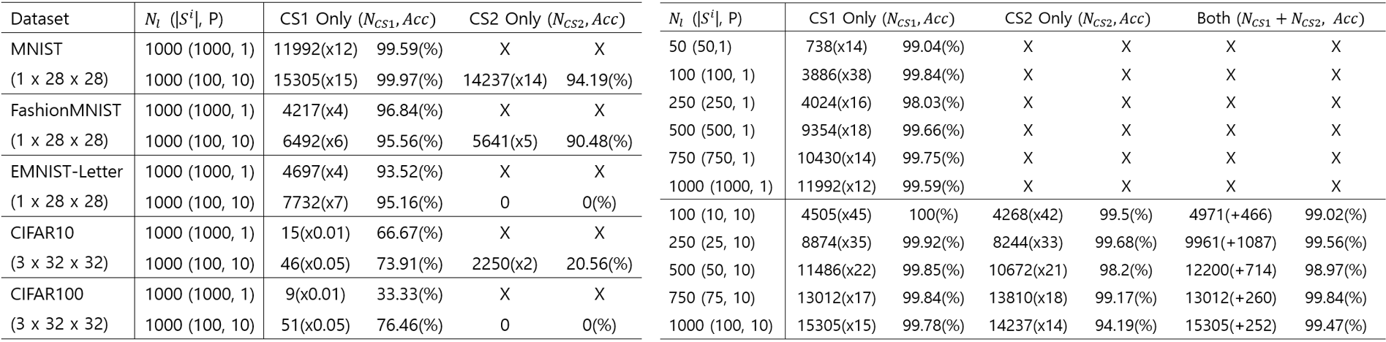
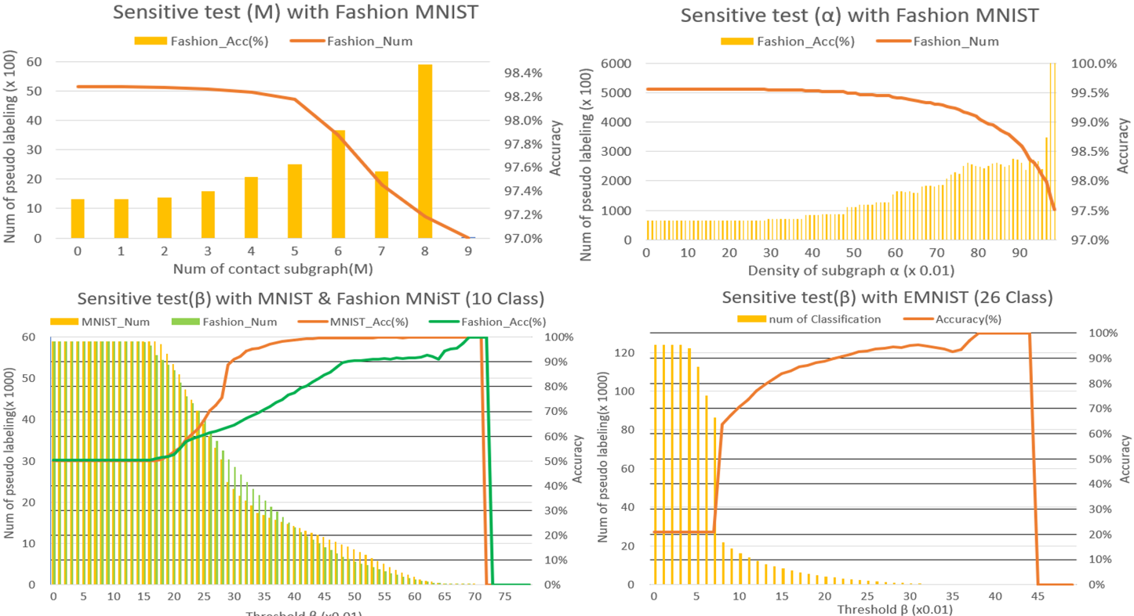
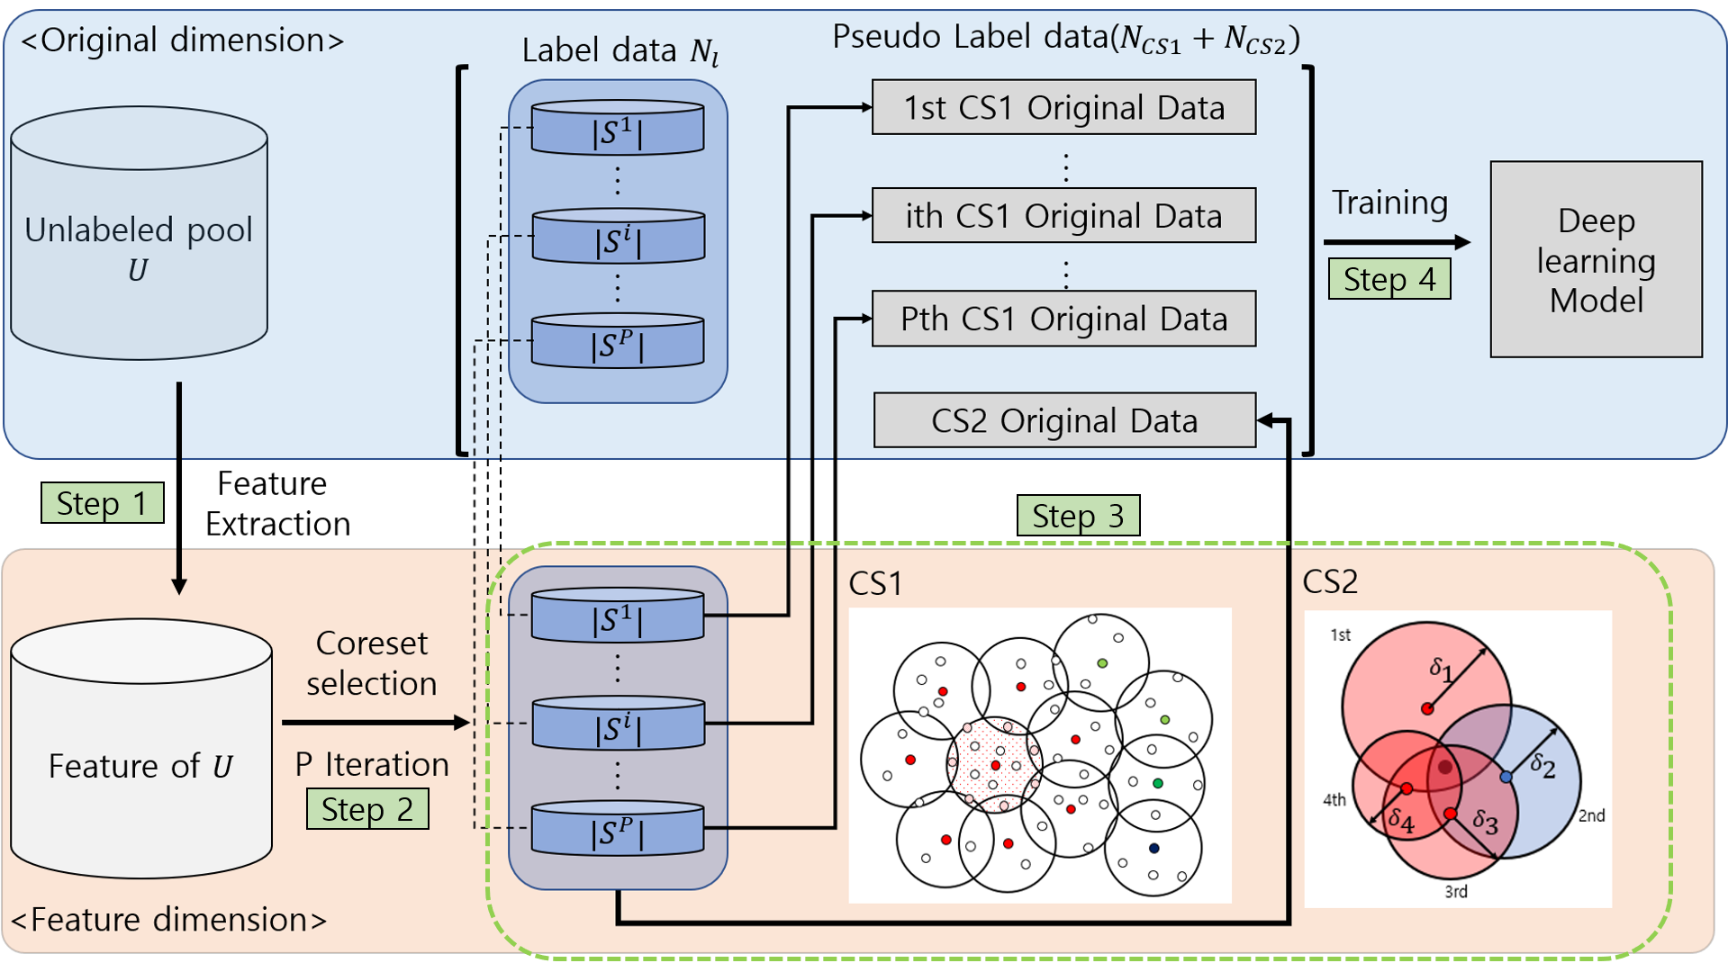
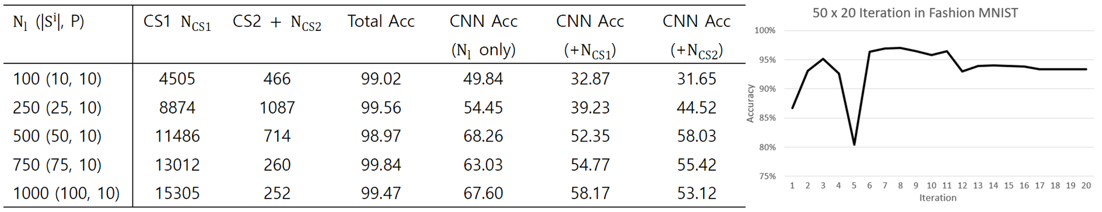
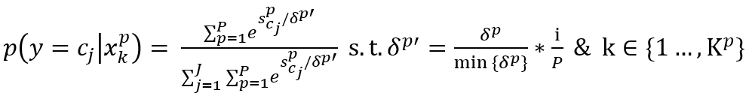
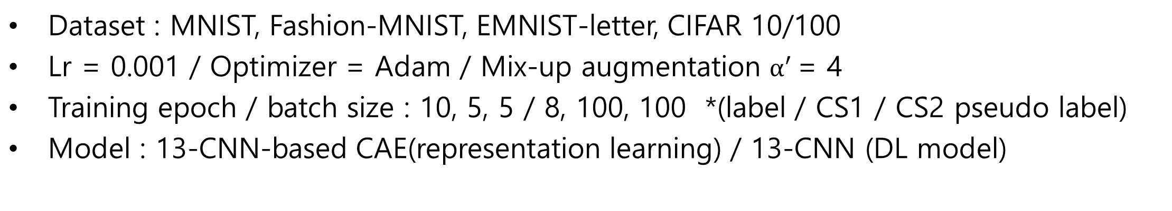
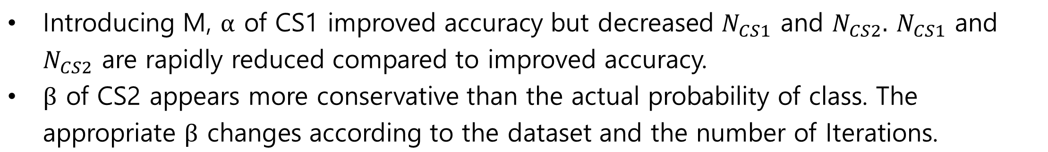
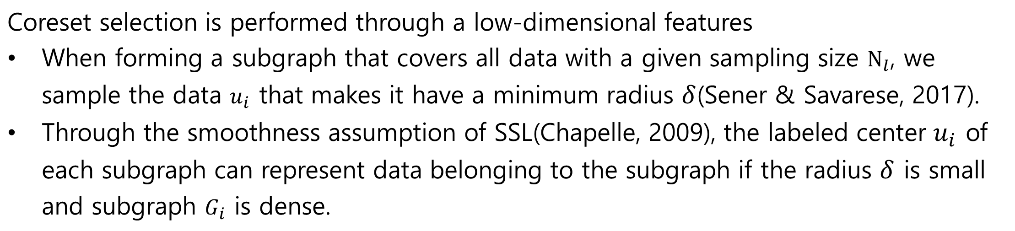
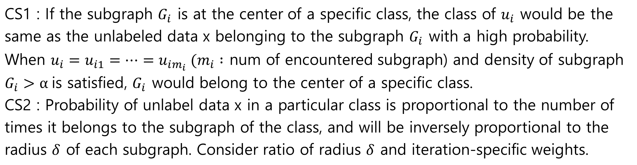
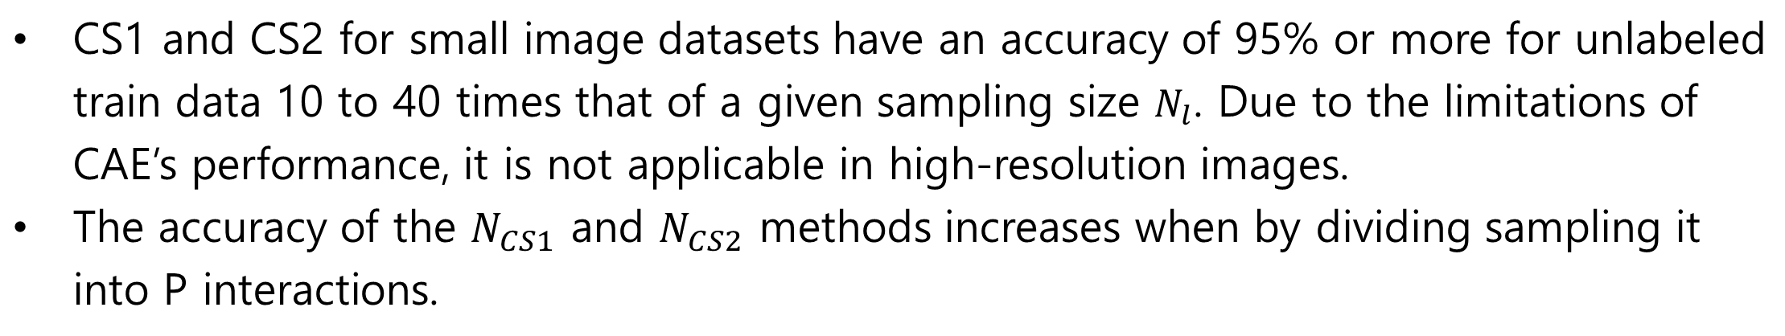
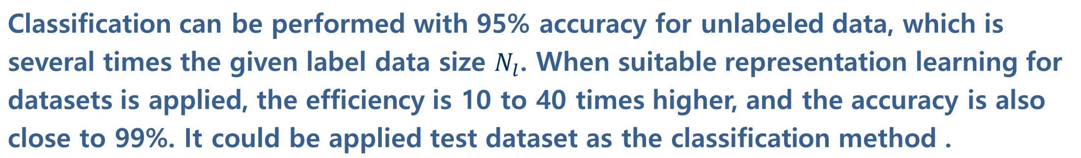
Solve Lack of Label Data : Partial Classification by Geometric Attribute of Coreset selection
Hyeongu Kang
Knowledge Innovation Research, GSDS, KAIST
Research Purpose
Experiment
Due to the labeling cost, it is difficult to secure enough label data to learn the model.
01 Datasets and training parameter
Problem 1
Problem 2
Dataset : MNIST, Fashion-MNIST, EMNIST-letter, CIFAR 10/100
Lr = 0.001 / Optimizer = Adam / Mix-up augmentation $α′$= 4
Training epoch / batch size : 10, 5, 5 / 8, 100, 100 *(label / CS1 / CS2 pseudo label)
Model : 13-CNN-based CAE(representation learning) / 13-CNN (DL model)
Most of pseudo labeling rely on the performance of the NN model.
Or it is unrealistic, they require
prior knowledge Of the dataset.
Lack of label data cannot guarantee the performance of neural network models.
Even a way to solve the labeling cost cannot be expected if label data is insufficient. Therefore, we need new a highly reliable pseudo labeling method that does not require a learning process through label data and can be applied without prior knowledge of the dataset is needed.
02 Performance of CS1 & CS2
[Table 1] [Table 2] * MNIST dataset
Research Question
RQ1. How high-accuracy pseudo labeling without NN model and prior knowledge?
CS1 and CS2 for small image datasets have an accuracy of 95% or more for unlabeled train data 10 to 40 times that of a given sampling size $N_{l}$. Due to the limitations of CAE’s performance, it is not applicable in high-resolution images.
The accuracy of the $N_{CS1}$ and $N_{CS2}$ methods increases when by dividing sampling it into P interactions.
Propose a new classification method utilizing Coreset-selection.
Each sampled data through the Coreset selection could be representative of the unlabeled data from a geometric perspective. Using this, we will perform high-accuracy classification for a large number of unlabeled data.
RQ2. How prevent confirmation bias of pseudo labeling?
03 Sensitive test for hyperparameter M, $α,$ $β$
A1. Prevention of over-trust of DL Model : Soft labeling / Mix-up data augmentation
A2. Ensuring high-accuracy of classification: Hyper-parameter setting
Method
Introducing M, $α$ of CS1 improved accuracy but decreased $N_{CS1}$ and $N_{CS2}.$ $N_{CS1}$ and $N_{CS2}$ are rapidly reduced compared to improved accuracy.
$β$ of CS2 appears more conservative than the actual probability of class. The appropriate $β$ changes according to the dataset and the number of Iterations.
04 Limitation
Step 01 - Feature extraction
Convolution autoencoder is applied to reduce image data to low-dimensional features
AL has difficult in applying to high-dimensional data such as Image data(Tong, 2001). DL with feature extraction capability can address limitation of AL(Ren et al., 2021)
Assume that CAE not only dimension reduce but also cluster data in low dimension
Auto encoder can capture the repetitive structure of data with dimension reduction(Y. Wang, Yao, & Zhao, 2016). In addition, when classification was performed in the k-nearest neighbor method after feature extraction, CAE was one of most accurate methods with an accuracy of 85%(Hurtik, Molek, & Perfilieva, 2020).
When pseudo label data with 99% accuracy is applied to learning, the performance down.
Similar data are not effective to training DL model.
A pseudo labeled data is imbalanced. Imbalanced labeled data causes overfitting, not generalization of the model.
Misclassified data would have a significant adverse effect on model learning.
When the sampling size is small, the accuracy may suddenly drop.
There may be cases in which the central class of the subgraph that encountered is the same even though it is not representative for subgraph.
Fundamental problem is the lack of performance of the representation learning. This case can be prevented by increasing the sampling size and assigning M conditions.
Step 02 - Coreset selection
Coreset selection is performed through a low-dimensional features
When forming a subgraph that covers all data with a given sampling size $N_{l}$, we sample the data $u_{i}$ that makes it have a minimum radius $δ$(Sener & Savarese, 2017).
Through the smoothness assumption of SSL(Chapelle, 2009), the labeled center $u_{i}$ of each subgraph can represent data belonging to the subgraph if the radius $δ$ is small and subgraph $G_{i}$ is dense.
Conclusion and future work
Step 03 - CS1 & CS2
Classification can be performed with 95% accuracy for unlabeled data, which is several times the given label data size $N_{l}$. When suitable representation learning for datasets is applied, the efficiency is 10 to 40 times higher, and the accuracy is also close to 99%. It could be applied test dataset as the classification method .
CS1 : If the subgraph $G_{i}$ is at the center of a specific class, the class of $u_{i}$ would be the same as the unlabeled data x belonging to the subgraph $G_{i}$ with a high probability. When $u_{i}=u_{i1}=…=u_{im_{i}} (m_{i} :$ num of encountered subgraph) and density of subgraph $G_{i}>α$is satisfied, $G_{i}$ would belong to the center of a specific class.
CS2 : Probability of unlabel data x in a particular class is proportional to the number of times it belongs to the subgraph of the class, and will be inversely proportional to the radius $δ$ of each subgraph. Consider ratio of radius $δ$ and iteration-specific weights.
Future work
01
Various types of representation learning methods such as ResNet 18 and DGI will be applied.
01
Apply data augmentation about unclassified class of CS1 & CS2 for solving imbalance of pseudo-labeled data
Step 04 - Training
01
Introduce threshold on loss value for mislabeled data detection
Train DL model with methods to help prevent confirmation bias
Soft labeling / Warm training
Mix-up data augmentation & small batch size setting(Arazo, 2020)
01
Improve CS2 method and generalize the $β$ by maximizing the number of Iterations. The dimension of feature can be increased to 3 and 4 dimensions.

